Slide 1
Secure Data Hiding in Image Using Steganography
CAPSTONE PROJECT
Presented By: SYED
Student Name : SYED AKRAM HUSSAIN
College Name & Department :
SRI VENKATESHWARA INSTITUTE OF TECHNOLOGY & COMPUTER SCIENCE AND ENGINEERING

Slide 2
OUTLINE
Problem Statement
Technology used
Wow factor
End users
Result
Conclusion
Git-hub Link
Future scope

Slide 3
Problem Statement
Secure communication is essential to protect sensitive data from unauthorized access. Steganography hides information within images, making it nearly undetectable. This project uses LSB encoding and Caesar Cipher encryption to securely embed and retrieve messages from images. The goal is to develop a user-friendly web application for safe and efficient data hiding.

Slide 4
Technology used
Python programming
Web Technologies
Flask library
Pillow library
Encryption Techniques
Decryption Techniques

Slide 5
Wow factors
A wow factor of this project is the dual-layer security—combining Caesar Cipher encryption with LSB steganography. Even if someone detects hidden data in the image, they still need to decrypt the encrypted message, adding an extra layer of protection!

Slide 6
End users
General Public
Developers

Slide 7
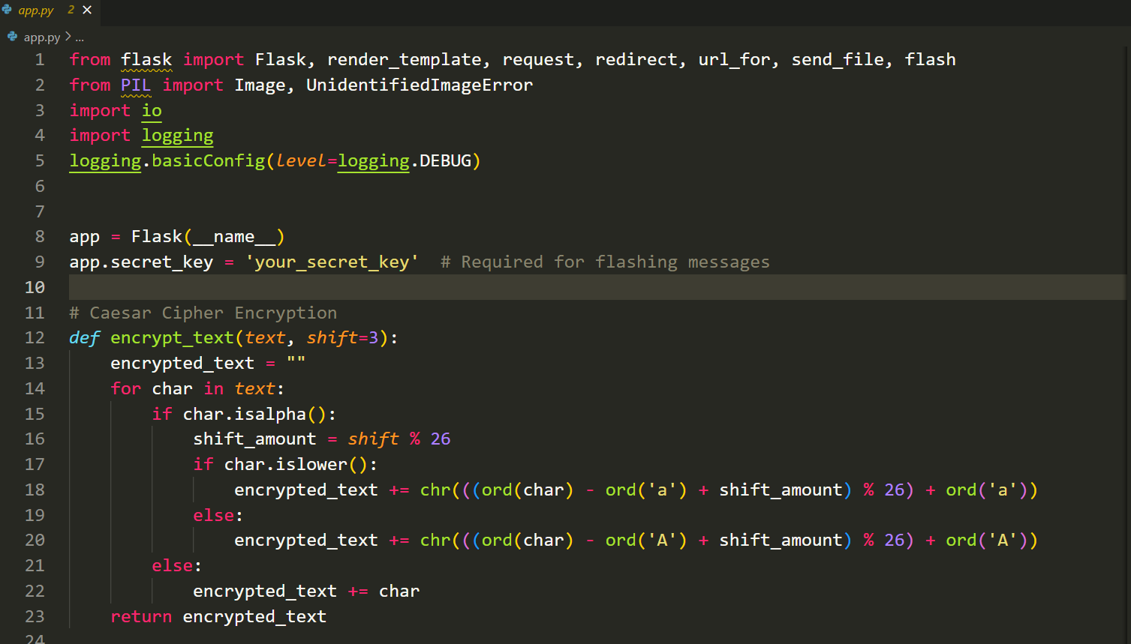
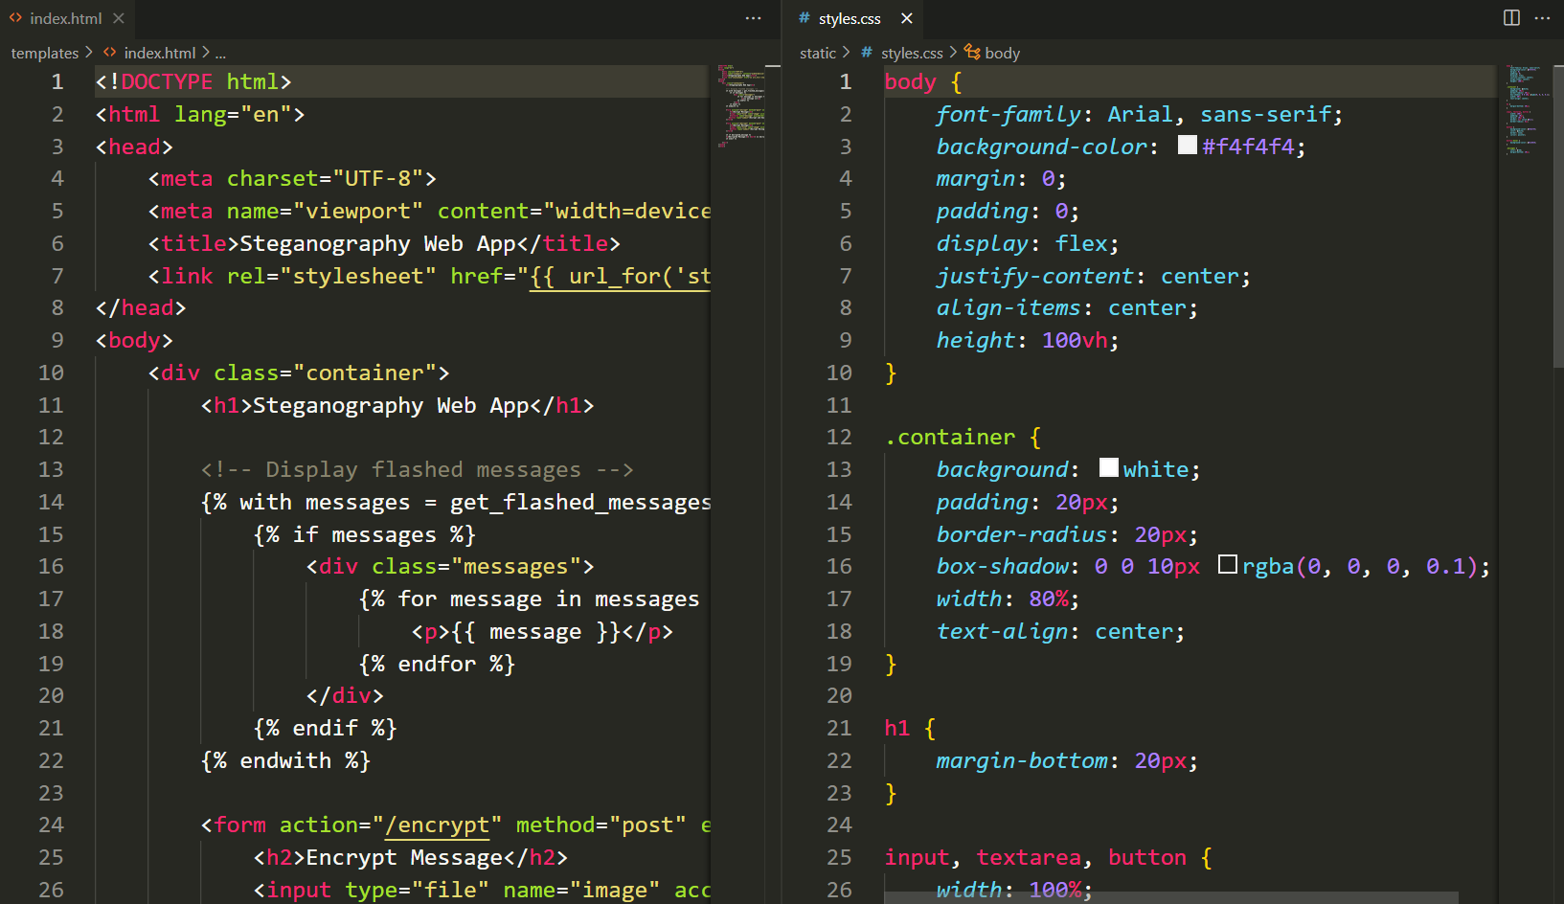
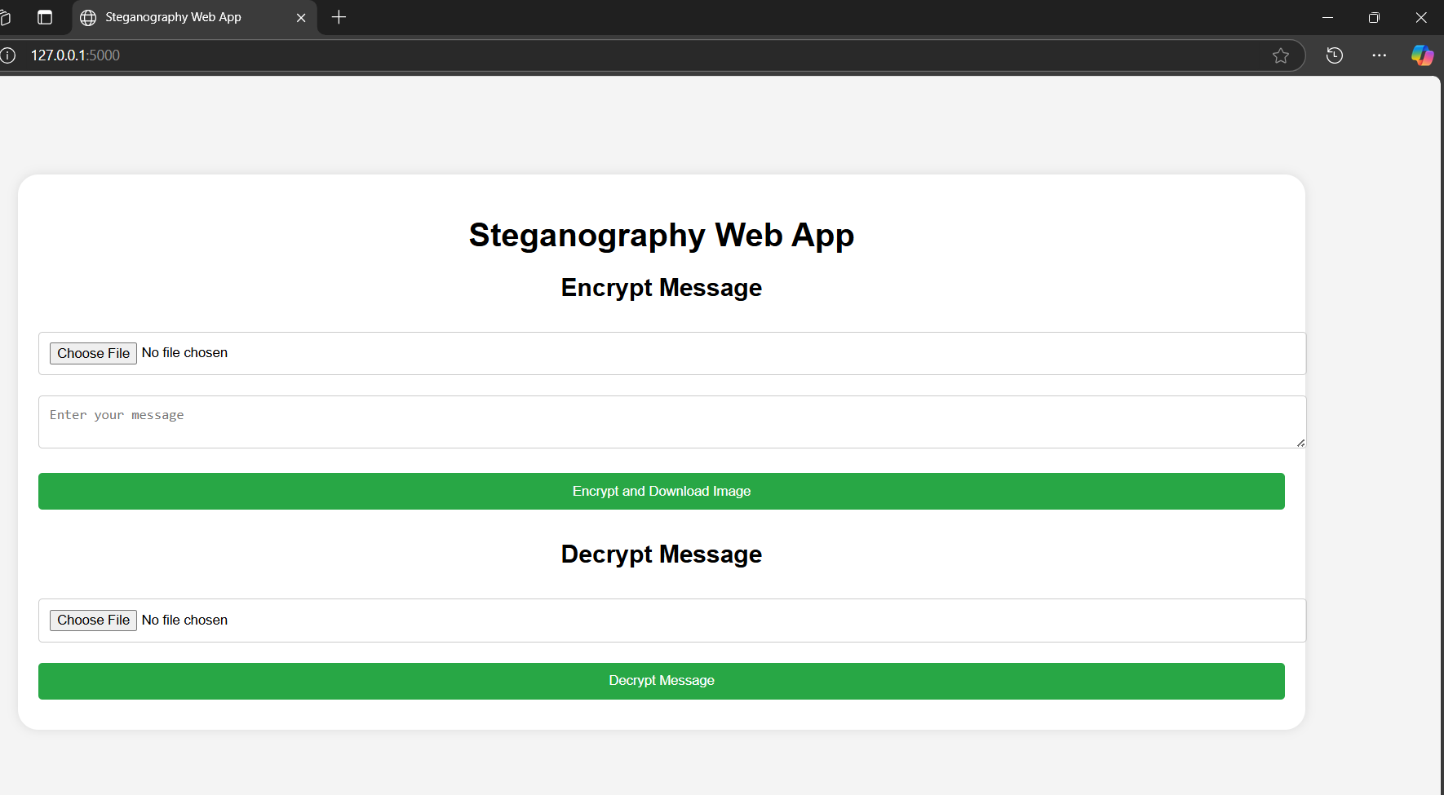
Results

Slide 8
Conclusion
In conclusion, our project successfully addresses the challenge of secure data hiding in images using steganography by integrating LSB-based image encoding with Caesar Cipher encryption. This dual-layer approach ensures that sensitive messages remain concealed and encrypted, providing enhanced security against unauthorized access. By implementing a user-friendly web application, we enable seamless encryption, embedding, extraction, and decryption of hidden messages, making this solution practical for secure communication in real-world applications.

Slide 9
GitHub Link
https://github.com/Akram110201/Secure_Data_Hiding_in_Image_Using_Steganography.git

Slide 10
Future scope(optional)
Future Scope of Secure Data Hiding in Image Using Steganography
Advanced Encryption Techniques – Integrating stronger encryption algorithms like AES or RSA along with steganography for enhanced security.
Multi-Layer Steganography – Hiding messages across multiple image layers or using different media formats like audio and video.
AI-Powered Detection Resistance – Implementing AI models to optimize encoding and prevent detection by steganalysis tools.
Cloud-Based Implementation – Developing a secure, cloud-based steganography service for real-time, global access.
Blockchain Integration – Using blockchain to ensure the integrity and authenticity of hidden messages for secure communications.
These enhancements will make steganography more secure, scalable, and resistant to cyber threats, ensuring its relevance in modern digital communication.

Slide 11
THANK YOU

